Slide 1
Creating Smart Raspberry PI Applications with Neural Networks
Zoran Sevarac, sevarac@gmail.com
Vladan Devedzic, devedzic@gmail.com
Laboratory for Artificial Intelligence
Open Source Software Development Center
University of Belgrade

Slide 2
Brief Overview
Neural networks on PI – create PI brain
Java Neural Network Framework Neuroph
PI Development Environment with NetBeans
PI, agent systems and neural networks

Slide 3
Neural Networks on PI
Neural networks are machine learning technique: they can learn from data and adapt their functionality
Typical type of problems include: classification, approximation, pattern and image recognition, control
Make adaptive PI capable of learning
With wide range of available sensors and data sources this can get very interesting
When to use neural networks

Slide 4
Java Neural Network Framework Neuroph
http://neuroph.sourceforge.net
Easily build & use neural networks in Java
Provides a set of jars which contain easy to use Java style API
Rich GUI Tools: Neuroph Studio, built on top of NetBeans Platform (wizard based tools, neural network visual editor & visualization)
Free, open source
Professional support available from Net Link Solutions http://www.netlink.rs
Dukes Choice Winner 2013.

Slide 5
HowTo
Build Java neural network using Neuroph Framework
- Define desired behaviour of neural network (I/O maping
- Collect data (from PI sensors)
- Prepare data (filter, normalize)
- Train network (learn network)
- Test network
Deploy neural network to Java application running on PI
using NetBeans

Slide 6
Build Neural Networks Using Neuroph
Import data
Create neural network using wizard
Train neural network
Test neural network
Repeat training (3), with modified network until you get desired results during testing
Save network as a .nnet file which is simply a serialized
NeuralNetwork object

Slide 7
Use Neural Network in Java Code
// load trained neural network from file
NeuralNetwork nnet = NeuralNetwork.createFromFile("SomeNet.nnet");
// set network input
nnet.setInput(someInputVector);
// calculate network
nnet.calculate();
// get network output
double[] output = nnet.getOutput();

Slide 8
Train Neural Network in Java Code
// create dataset
DataSet dataSet = DataSet.createFromFile(...);
// create neural network
MultiLayerPerceptron nnet = new MultiLayerPerceptron(4, 5, 3);
// train network
nnet.learn(dataSet);

Slide 9
ImageRecognition Plugin
Aplication specific neural network wrapper
// get the image recognition plugin from neural network
ImageRecognitionPlugin imageRecognition =
(ImageRecognitionPlugin)nnet.getPlugin(
ImageRecognitionPlugin.class);
HashMap<String, Double> output =
imageRecognition.recognizeImage(image);

Slide 10
Neuroph Plugin System – Extension Point
Custom plugins should wrap a neural network with some application specific API (like image recognition )
Extend PluginBase from Neuroph and add methods you need
Add it to neural network using nnet.addPlugin() method
Get it using nnet.getPlugin() method

Slide 11
NetBeans PI Development Environment
With NetBeans you can develop (& debug) on your local machine and run remotely on PI
Easy setup:
SSH running on PI (and use keys for authentication)
Add Remote Java Platform to NetBeans
Set Remote Java Platform in Run configuration of your project

Slide 12
Available Sensors and Ideas
Temperature, air pressure, humidity
Light
Ultrasonic (distance)
Infra Red (movement, presence)
Accelorometer (motion and direction)
Camera (video, photo)
Other stuff that can come over network or USB

Slide 13
Agents in a nutshell
Generic agent
Percepts
Sensors
Environment
?
Agent
Actions
Effectors
Design

Slide 14
Agents in a nutshell
Inside an agent
Other agents
Sensors
Communication layer
?
Agent
Coordination layer
Effectors
Organization layer
Definition layer
Design
API layer

Slide 15
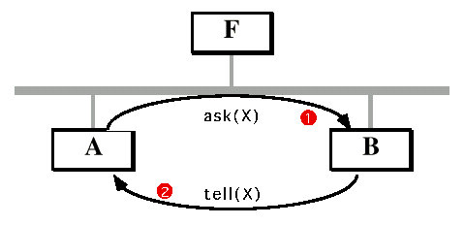
Agents in a nutshell
Point-to-point communication (no facilitator)

Slide 16
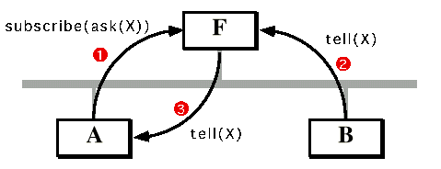
Agents in a nutshell
Monitoring other agents

Slide 17
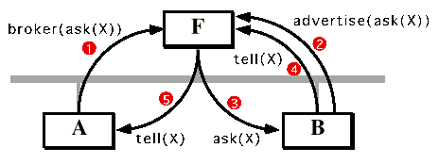
Agents in a nutshell
Brokering

Slide 18
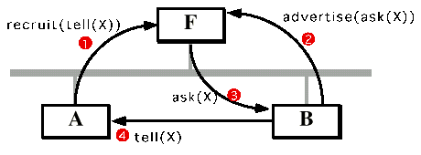
Agents in a nutshell
Establishing direct communication between agents

Slide 19
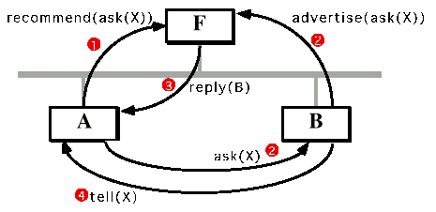
Agents in a nutshell
Matchmaking

Slide 20
Agents in a nutshell
Facilitators in a "federative system"

Slide 21
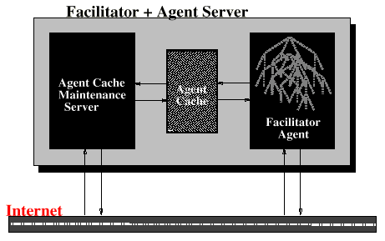
Agents in a nutshell
Facilitator as an "agent server"

Slide 22
Slide author:
Gordon McCalla,
U. Od Saskatchewan
Thanks, Gord!
HA
WEB
?
?
PDF
MATCHMAKER
?
I-Help

Slide 23
Slide author:
Milovan Tosic,
Mozzart Bet, Serbia
Thanks, Milovan!
Crawler agents

Slide 24
Slide author:
Milovan Tosic,
Mozzart Bet, Serbia
Thanks, Milovan!
Crawler agents

Slide 25
Slide author:
Milovan Tosic,
Mozzart Bet, Serbia
Thanks, Milovan!
Crawler agents

Slide 26
Slide author:
Milovan Tosic,
Mozzart Bet, Serbia
Thanks, Milovan!
Crawler agents

Slide 27
Slide author:
Milovan Tosic,
Mozzart Bet, Serbia
Thanks, Milovan!
Crawler agents

Slide 28
Slide author:
Milovan Tosic,
Mozzart Bet, Serbia
Thanks, Milovan!
Crawler agents

Slide 29
Slide author:
Milovan Tosic,
Mozzart Bet, Serbia
Thanks, Milovan!
Crawler agents

Slide 30
Slide author:
Milovan Tosic,
Mozzart Bet, Serbia
Thanks, Milovan!
Crawler agents

Slide 31
Slide author:
Milovan Tosic,
Mozzart Bet, Serbia
Thanks, Milovan!
Crawler agents

Slide 32
Agent scenarios with NN and PI
PI stores the training dataset, agent takes it and trains the NN on a cloud and returns it to PI
PI is still too weak (CPU) to train a complex NN
PI stores the NN, agent takes it from PI to get a behavior and then runs it
over time, another agent can replace the NN on PI with another NN

Slide 33
FIPA Java Agent Frameworks
JAVA Agent DEvelopment Framework - JADE
http://jade.tilab.com/
Java-based Intelligent Agent Componentware
http://www.jiac.de
Jadex
http://www.activecomponents.org/

Slide 34
More AI on PI: Agent Systems and Neural Networks
Agent Systems (like JADE, or any other FIPA compliant)
They can provide collaborative, distributed processing
Agents running of different PIs can communicate and collaborate
They can move from one PI to another, through the network
They can specialize for specific tasks
They can learn and adapt
There are Agent Systems specialised for specific type of tasks, but as long as they are FIPA compliant they can collaborate
FIPA defines: runtime environment (an agent container), lifecycle of the agent, registration of the agent in system, messaging protocol

Slide 35
GOOD OLD AI group/network
http://goodoldai.org
Artificial Intelligence Laboratory
Open Source Software Development Center
University of Belgrade
AI researchers and software engineers working together
External members

Slide 36
Usefull links
Get Neuroph
http://neuroph.sourceforge.net
Get NetBeans
http://www.netbeans.org
NetBeans PI tutorials
http://jaxenter.com/how-to-deploy-debug-and-profile-java-on-the-raspberry-pi-50890.html
http://netbeans.dzone.com/articles/nb-8-raspberry-pi-end2end
https://blogs.oracle.com/speakjava/entry/integrating_netbeans_for_raspberry_pi

